Slide 1
LIBRARY MANAGEMENT SYSTEM
Developed By: Santosh Adhikari Bikesh Khyaju Sujan Subedi
Batch: 2020 Faculty: Science and technology Program: Bachelor of information technology

Slide 2
CONTENTS
Introduction Problem Statement Goals And Objectives Drawbacks Gantt Chart Conclusion

Slide 3
INTRODUCTION
Library Management system is also developed with same concept of making Library management much faster and easier. A Library Management System is software built to handle the primary housekeeping functions of a library Library management systems help libraries keep track of the books and there details As students, staffs and books are all related terms of the libraries, there should be proper way of management in Library Management system. The records of the students, books and staffs should be kept and should be known to the authorized people only.

Slide 4
Problem statement
Valuable time wasted from inconvenient and less efficient ways of recording. Paper is used for recording books add students’ information.

Slide 5
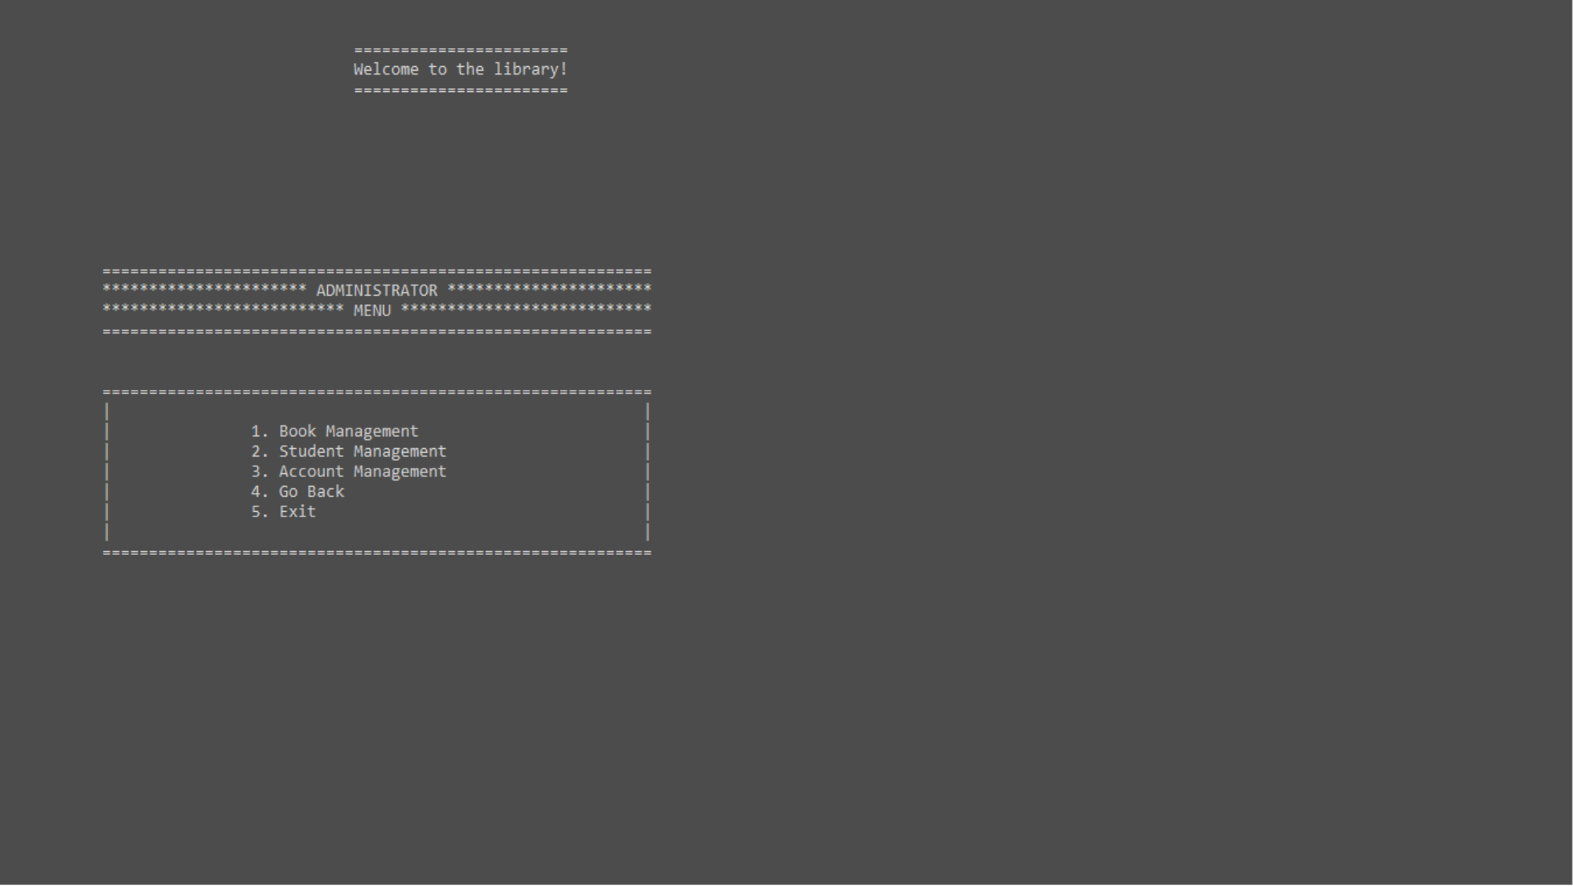
GOALS AND OBJECTIVE
User friendly User can do his operations comfortably. Saving Time Faster performance. User can easily access the stored data edit them for further use. Easy to use User can use the system easily without confusion.

Slide 6
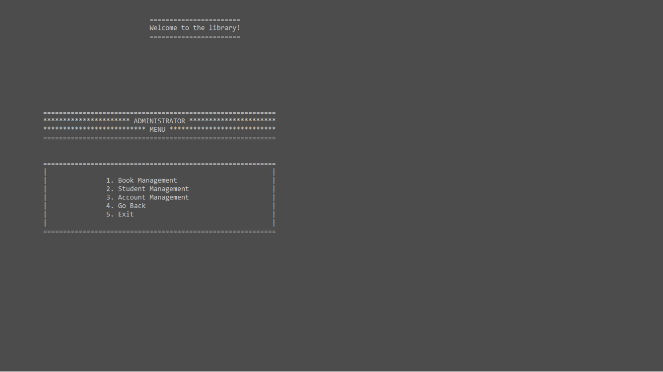
Problem faced
This was the first project in c. So, many mistakes were experienced. Lots of bugs were found and debugging took longer time. No technical knowledge to do systematic programming. As the number of codes increased coding becomes difficult and more challenging. Lack of Interaction between the team members because of the pandemic and lockdown.

Slide 7
DRAWBACKS
Some of the ideas were not kept due to lack of skills and bugs. Some of the features have some issues in displaying information.

Slide 8
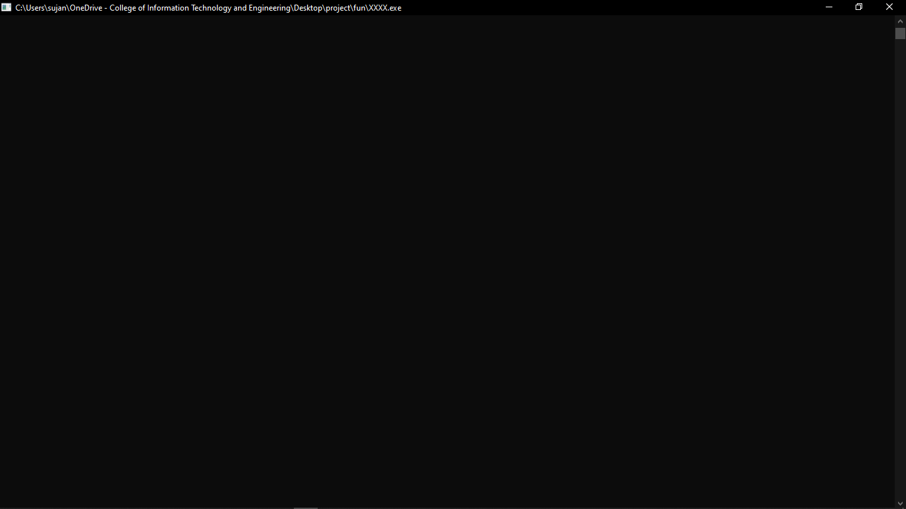
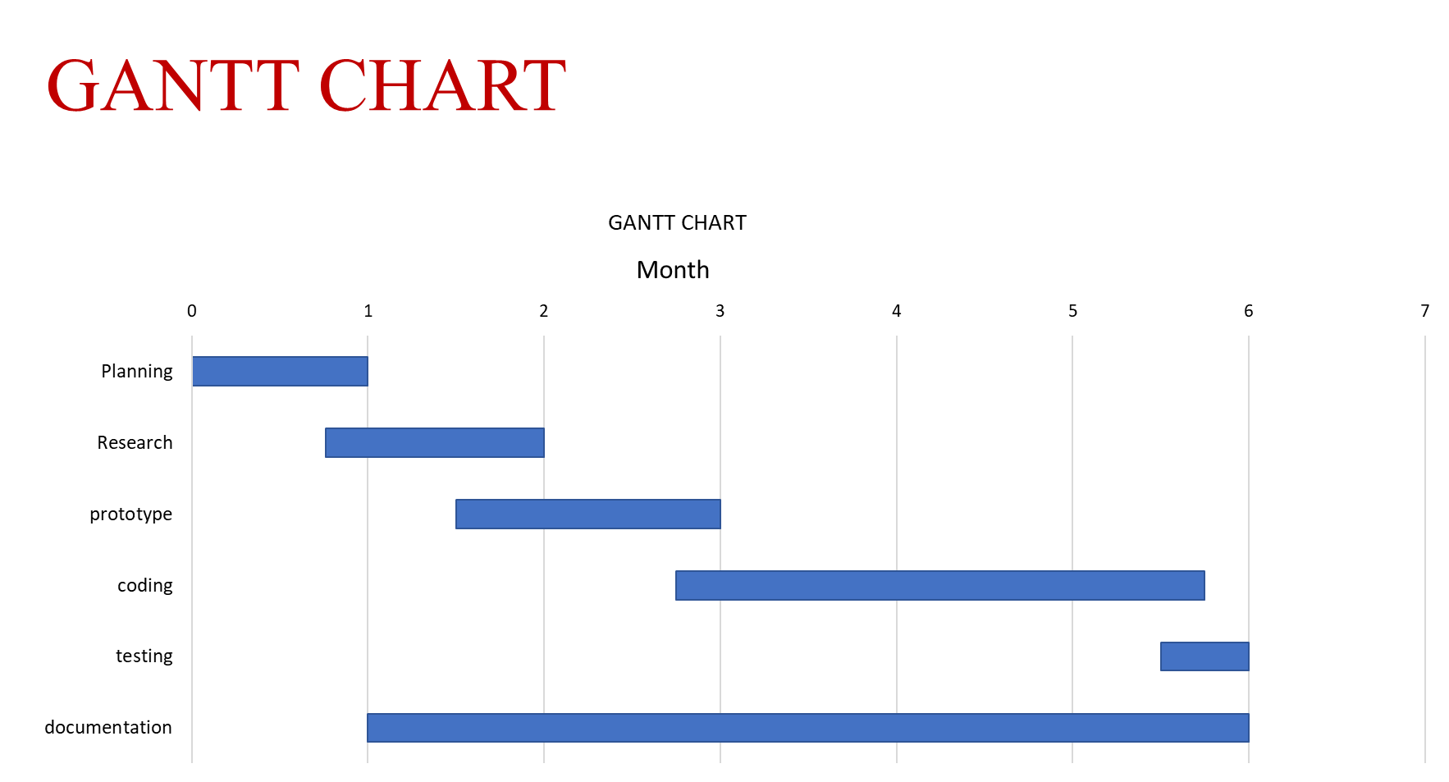

Slide 9

FUNCTIONS USED
Header file | Library function | Description
ADMIN admain.h acount.h admreg.h | ad_main() acc() admin_register() | These is the header file of the dmin panel.
STUDENT student.h stumain.h | student_login() stu_chose() | These is the header file of the student panel.
book.h | book_main() | These is the header file of the book details.
login.h | admin_ligin() user_exists() | These is the header file for admin login, check admin, register admin
Header file | Description
main() | Welcome screen is shown
ch_menu() | 4 choice is shown in the screen for admin, student, book, exit
admin_login() student_login() | Login screen ask for username and password.
ad_main() | Admin panel first screen to choose an option
acc() | Manage Admin records
stu_chose() | Student panel first screen to choose an option
book_main() | Book panel first screen to choose an option

Slide 10
CONCLUSION
This is a system for library to use in order to manage their book records like Books information, number of book borrowed, no. of books returned. With the help of this program, we can store book records, admin information, student information, manage student information and so on.

Slide 11
REFRENCES
https://github.com/RanaBKamal/bitprojecti https://aticleworld.com/library-management-system-project-in-c/

Slide 12
THANK YOU

